Slide 1
Histopathologic Oral Cancer Detection using Decision Tree and XG Boosting

Slide 2
Vineeth Reddy Maadugula - 700742040 Preetham Reddy Kesireddy - 70074129 Azargani - 700726234 Alekhya Bhimireddy - 700724917

Slide 3
Roles and Responsibilties Description: Identifying bench mark dataset. Gathering datasets and choosing the most relevant dataset from the internet according to our requirement. Implementing various techniques for the dataset and to find the accuracy. Person Assigned : Preetham Kesireddy Description: Loading the data i.e resizing the data which we have taken from data set to respective input size based on the models we used to train them. Image Data Visualization is done. Person Assigned: Vineeth Reddy Maadgula Description: Implement XG Boosting algorithm and Decision Tree algorithm for the given dataset and find the accuracy. Model evaluation and Documentation is done. Person Assigned : Azargani and Alekhya Bhimireddy

Slide 4
Significance
Oral cancer is the most common type of head and neck cancer worldwide, leading to approximately 177,757 deaths every year.
When identified at early stages, oral cancers can achieve survival rates of up to 75–90%.
However, the majority of the cases are diagnosed at an advanced stage mainly due to the lack of public awareness about oral cancer signs and the delays in referrals to oral cancer specialists.
As early detection and treatment remain to be the most effective measures in improving oral cancer outcomes, the development of vision-based adjunctive technologies that can detect oral potentially malignant disorders (OPMDs), which carry a risk of cancer development, present significant opportunities for the oral cancer screening process.

Slide 5
Introduction
Over the last few decades, the discipline of cancer analysis has made significant development.
In order to assess the kinds and stages of the illness, scientists have developed a number of screening techniques for early cancer detection.
With the development of new technologies, a vast quantity of cancer information has been amassed and is now accessible for use in cancer research by the medical research community.
However, one of the greatest obstacles for physicians is exactly predicting the kind of cancer that will develop.
As a result, medical researchers use a number of machine-learning techniques to help in their studies.
These algorithms are capable of finding patterns and their relationships, as well as effectively forecasting the future outcomes of a disease type from complicated data, which is especially important for cancer.
Due to the rising popularity of machine learning methods, this study provides an overview of research that has used these approaches to predict oral cancer.

Slide 6
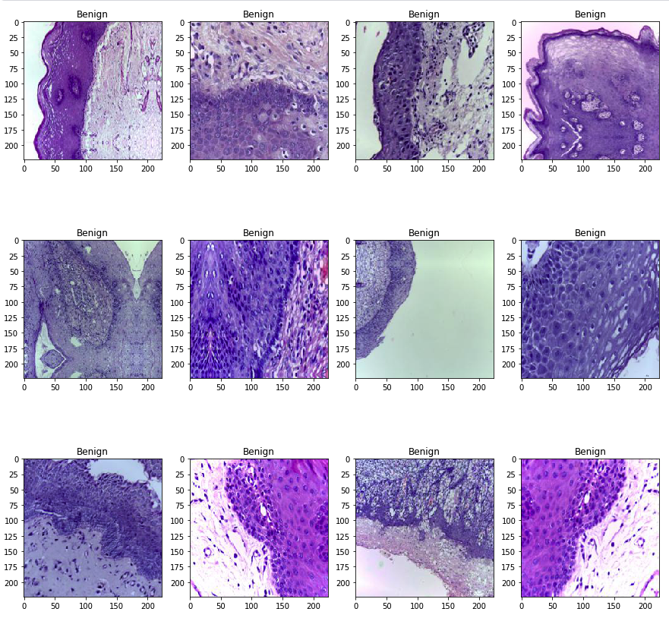
Datasets
2500 photos with oral cancer and 2500 images without cancer were included in the oral cancer histopathology imaging databases.
It features photos of the lips and tongue that are divided into two categories: malignant and non-cancerous cells. This is an issue of binary classification.
The photos in our sample had a median width and height of 546 and 397 pixels, respectively, and a median width and height of 397 pixels.

Slide 7
Data Preparation
Images at the lowest level of abstraction are referred to as image pre-processing, which is the same as image processing.
In pre-processing, the goal is to make the image data better by suppressing unwanted distortions and enhancing some visual properties that are important for the task of subsequent processing and analysis after it has been captured.
Several pre-processing procedures must be performed on the input data before it can be used.
These procedures may comprise the following steps:
Formatting & Resizing
Enhancement
Region of Interest (ROI) Extraction
Data balancing

Slide 8
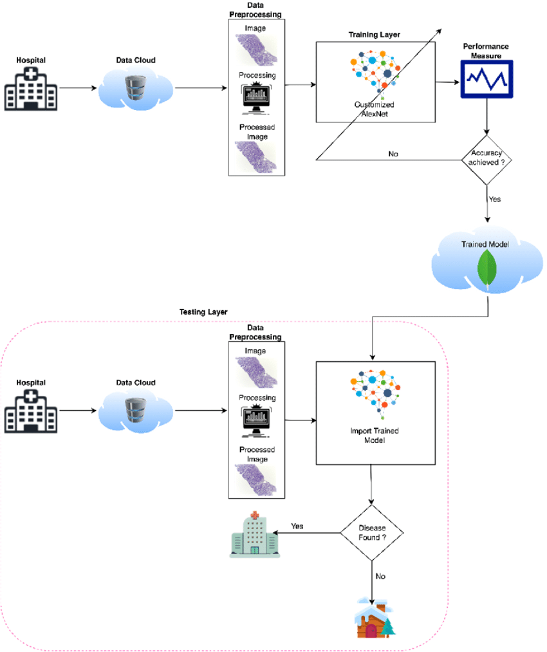
Methodology

Slide 9
Modeling
The model was developed using a Decision Tree and XG Boosting techniques.
In the following step, the proposed model was tested against the test dataset.
1 Start
2 Input Oral Cancer Data from Data Cloud
3 Pre-process Oral Cancer data
4 Load Data
5 Load Customized Model
6 Prediction of Oral Cancer using Machine Learning Learning (AlexNet)
7 Training Phase
8 Image Testing Phase
9 Compute the Performance and Accuracy of the proposed model by using the Performance Matrix
10 Finish

Slide 10
XG Boosting
XGBoost is a decision-tree-based ensemble Machine Learning method that makes use of a gradient-boosting framework in order to enhance accuracy and speed.
XGBoost was developed by Microsoft Research and is named after the company's founder.
In prediction problems involving unstructured data (pictures, text, and so on), the performance of artificial neural networks tends to outperform that of every other algorithm or framework.
However, decision tree-based algorithms are regarded as the most effective method for handling small to medium-sized structured or tabular data sets.
Both XGBoost and Gradient Boosting Machines (GBMs) are examples of ensemble tree methods.
These ensemble tree methods both make use of the gradient descent architecture to apply the principle of boosting weak learners (in general, CARTs) in order to enhance their performance.

Slide 11
Decision Tree
Decision Trees are a sort of Supervised Machine Learning (in which you describe what the input data is and what the associated output data is in the training data) in which the data is continually separated according to a specific parameter, as opposed to unsupervised machine learning.
Two entities, namely decision nodes, and leaves, can be used to explain the structure of the tree.
The decisions or final outcomes are represented by the leaves.
And the decision nodes are the points at which the data is divided.
A Decision Tree is a Supervised learning technique that may be used to solve classification and regression problems.
However, it is most commonly used to solve classification problems.
There are two nodes in a decision tree, which are referred to as the Decision Node and the Leaf Node.
In contrast to Decision nodes, which are used to make any decision and have numerous branches, Leaf nodes are the result of such decisions and do not contain any more branches

Slide 12
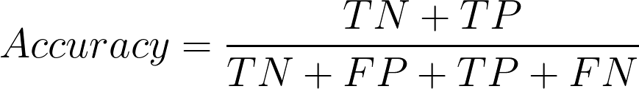
Validation Method
This statistic describes how well the model performs across all classes and is used to evaluate its accuracy.
Heuristics are used to calculate this as the ratio of correct guesses to the total number of forecasts.
The accuracy of a data set is defined as the proportion of correctly classified data instances to the total number of data sets.
If the dataset is not balanced, accuracy may not be a useful metric to use (both negative and positive classes have different numbers of data instances).

Slide 13
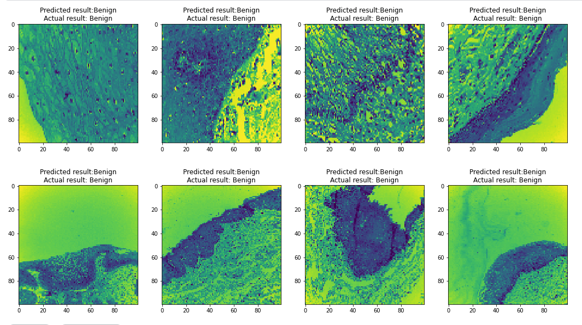
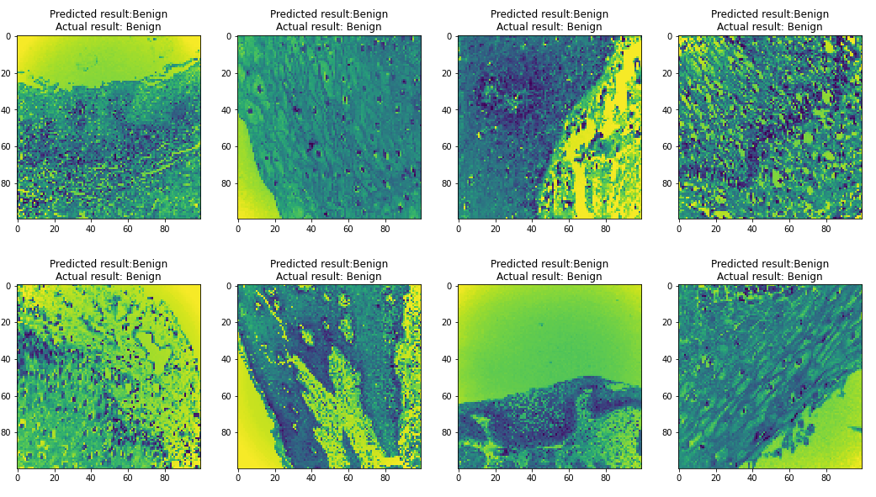
Results
It was necessary to verify the acquired result and model in multiple photos in order to evaluate the proposed approach.
Malignant tumors are distinguished from benign tumors in their classification.
It was discovered that the proposed decision tree had an accuracy of 59 percent.
And the suggested XG Boosting was found to be accurate to within 64%.
Decision tree model Accuracy
XG Boosting model performance

Slide 14
Conclusion
As part of this research, we created a machine-learning algorithm for an autonomous cancer diagnostic system.
They present the features of hyperspectral medical images of oral cancer case studies that were investigated.
The stochastic neighbor embedding method was also used to graphically represent the elements of the hyperspectral image that were under investigation.
According to this algorithm, 66 percent of the results are accurate.
Additionally, they demonstrate an increase in accuracy of 4.5 percent when a significant number of cancer subject data sets are used for the training phase, resulting in 500 picture datasets being obtained.
As a result, the processing system correctly predicted whether the tumor was a malignant tumor or a benign tumor in this analysis.
To improve the accuracy of the model, we must employ a deep learning-based way of training the model.
When employing a pretrained model, image categorization outperforms when using a trained model.

Slide 15
References:
1.Hanahan D, Weinberg RA. Hallmarks of cancer: the next generation. Cell 2011; 144(5): 646-74.
2.Leung F, Eberlin LS, Schwamborn K, Heeren RMA, Winograd N, Cooks RG. Mass spectrometry-based tissue imaging: the next frontier in clinical diagnostics? Clin Chem 2019; 65(4): 510-3.
3.Ifa DR, Eberlin LS. Ambient ionization mass spectrometry for cancer diagnosis and surgical margin evaluation. Clin Chem 2016; 62(1): 111-23.
4.Porcari AM, Zhang J, Garza KY, et al. Multicenter study using desorption-electrospray-ionization-mass-spectrometry imaging for breast-cancer diagnosis. Anal Chem 2018; 90(19): 11324-32.
5.Tata A, Gribble A, Ventura M, et al. Wide-field tissue polarimetry allows efficient localized mass spectrometry imaging of biological tissues. Chem Sci (Camb) 2016; 7(3): 2162-9.
6.Woolman M, Tata A, Bluemke E, Dara D, Ginsberg HJ, Zarrine-Afsar A. An assessment of the utility of tissue smears in rapid cancer profiling with desorption electrospray ionization mass spectrometry (DESI-MS). J Am Soc Mass Spectrom 2017; 28(1): 145-53.
7.Tata A, Woolman M, Ventura M, et al. Rapid detection of necrosis in breast cancer with desorption electrospray ionization mass spectrometry. Sci Rep 2016; 6: 35374.
8.Ristevski B, Chen M. Big data analytics in medicine and healthcare. J Integr Bioinform 2018; 15(3)
9.Gurcan MN, Boucheron LE, Can A, Madabhushi A, Rajpoot NM, Yener B. Histopathological image analysis: a review. IEEE Rev Biomed Eng 2009; 2: 147-71.
10.Onder D, Sarioglu S, Karacali B. Automated labelling of cancer textures in colorectal histopathology slides using quasi-supervised learning. Micron 2013; 47: 33-42.
11.Unsupervised segmentation and classification of cervical cell images. Pattern Recognit 2012; 45(12): 4151-68.
12.Ojansivu V, Linder N, Rahtu E, et al. Automated classification of breast cancer morphology in histopathological images. Diagn Pathol 2013; 8(1): S29.
13.Patel JL, Goyal RK. Applications of artificial neural networks in medical science. Curr Clin Pharmacol 2007; 2(3): 217-26.
14.Cireşan DC, Giusti A, Gambardella LM, Schmidhuber J. Mitosis detection in breast cancer histology images with deep neural networks. International Conference on Medical Image Computing and Computer-assisted Intervention 411-8.
15.Zhuo L, Jiang L, Zhu Z, Li J, Zhang J, Long H. Vehicle classification for large-scale traffic surveillance videos using convolutional neural networks. Mach Vis Appl 2017; 28(7): 793-802.
16.Lim LAG, Maguib RN, Dadios EP, Avila JMC. Implementation of GA-KSOM and ANFIS in the classification of colonic histopathological imagesTENCON 2012 IEEE Region 10 Conference 2012; 1-5.
17.Li C, Zhang S, Zhang H, et al. Using the K-nearest neighbor algorithm for the classification of lymph node metastasis in gastric cancer. Comput Math Methods Med 2012; 2012876545
18.Chen G, Zhang J, Zhuo D, Pan Y, Pang C. Identification of pulmonary nodules via CT images with hierarchical fully convolutional networks. Med Biol Eng Comput 2019; 57(7): 1567-80.
19.Sertel O, Kong J, Shimada H, Catalyurek UV, Saltz JH, Gurcan MN. Computer-aided prognosis of neuroblastoma on whole-slide images: Classification of stromal development. Pattern Recognit 2009; 42(6): 1093-103.
20.Tseng CJ, Lu CJ, Chang CC, Chen GD. Application of machine learning to predict the recurrence-proneness for cervical cancer. Neural Comput Appl 2014; 24(6): 1311-6.
Stojadinovic A, Nissan A, Eberhardt J, Chua TC, Pelz JO, Esquivel J. Development of a Bayesian Belief Network Model for personalized prognostic risk assessment in colon carcinomatosis. Am Surg 2011; 77(2): 221-30.

